Slide 1
Greedy Algorithm
Hongzhi Wang

Slide 2
Greedy Algorithm
Based on trying best current (local) choice
Approach
  At each step of algorithm
  Choose best local solution
Avoid backtracking, exponential time O(2^{n})
Hope local optimum lead to global optimum
Notes:
2

Slide 3
Greedy Algorithm – Example
Problem: Find minimum set of coins to give change of K cents
1,2,5,10,25 cent coins
Greedy algorithm: pick largest coin in each step
This algorithm does not work for any coin values. E.g., if 21 cent coin existed, it would fail for k=63.

Slide 4
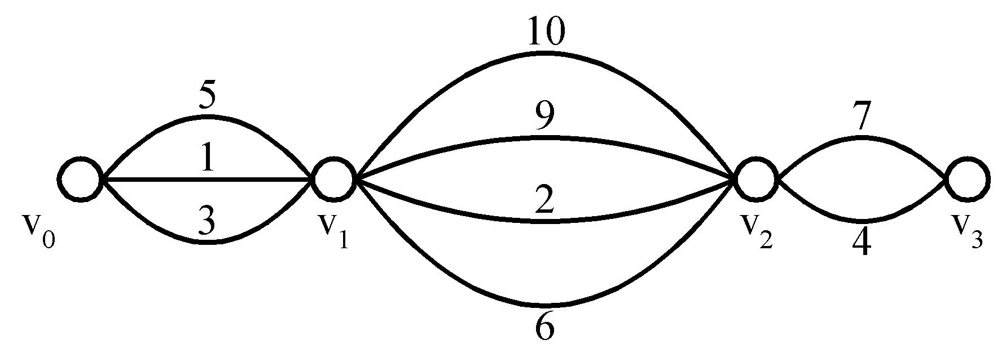
Shortest paths on a special graph
Problem: Find a shortest path from v₀ to v₃.
The greedy method can solve this problem.
The shortest path: 1 + 2 + 4 = 7.

Slide 5
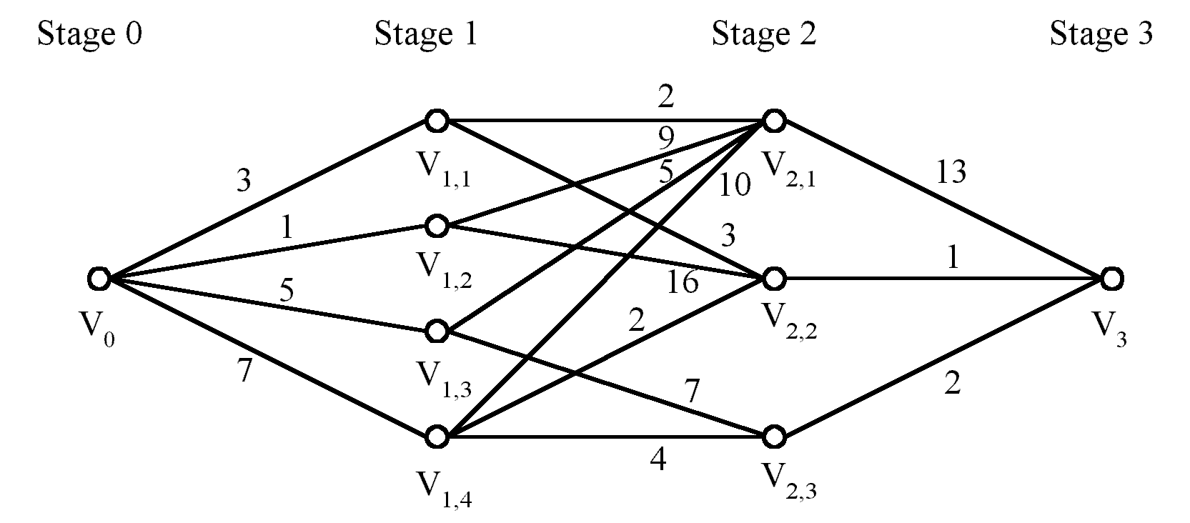
Shortest paths on a multi-stage graph
Problem: Find a shortest path from v₀ to v₃ in the multi-stage graph.
Greedy method: v₀v_{1,2}v_{2,1}v₃ = 23
Optimal: v₀v_{1,1}v_{2,2}v₃ = 7
The greedy method does not work.

Slide 6
Greedy Algorithm
Greedy algorithms make locally optimal decisions at each step. This is simple, but not always the correct things to do

Slide 7
The problem of giving change

Slide 8
Making Change Example
Problem: Find the minimum # of quarters, dimes,
nickels, and pennies that total to a given amount.

Slide 9
Making Change Example
Instances: A set of objects
and a relationship between them.
Amount = 92¢
25¢
25¢
25¢
25¢
25¢
25¢
25¢
25¢
25¢
25¢
10¢
10¢
10¢
10¢
10¢
10¢
10¢
10¢
10¢
10¢
5¢
5¢
5¢
5¢
5¢
5¢
5¢
5¢
5¢
5¢
1¢
1¢
1¢
1¢
1¢
1¢
1¢
1¢
1¢
1¢
  Solutions for Instance:
  A subset of the coins that total the amount.
Some subsets are not allowed
because some objects conflict

Slide 10
Making Change Example
Instances: A set of objects
and a relationship between them.
Amount = 92¢
25¢
25¢
25¢
25¢
25¢
25¢
25¢
25¢
25¢
25¢
10¢
10¢
10¢
10¢
10¢
10¢
10¢
10¢
10¢
10¢
5¢
5¢
5¢
5¢
5¢
5¢
5¢
5¢
5¢
5¢
1¢
1¢
1¢
1¢
1¢
1¢
1¢
1¢
1¢
1¢
  Solutions for Instance:
  A subset of the coins that total the amount.
Cost of Solution: The number of coins = 14
  Goal: Find an optimal non-conflicting solution.

Slide 11
Making Change Example
Instances: A set of objects
and a relationship between them.
25¢
Amount = 92¢
50¢
25¢
75¢
25¢
25¢
25¢
25¢
25¢
25¢
25¢
25¢
25¢
100¢
85¢
10¢
10¢
10¢
10¢
10¢
95¢
10¢
10¢
95¢
10¢
10¢
10¢
90¢
5¢
91¢
5¢
5¢
5¢
5¢
5¢
5¢
5¢
5¢
5¢
92¢
1¢
1¢
1¢
1¢
1¢
1¢
1¢
1¢
1¢
1¢
Greedy Choice:
Start by grabbing quarters until exceeds amount,
then dimes, then nickels, then pennies.
Does this lead to an optimal # of coins?
Cost of Solution: 7

Slide 12
Hard Making Change Example
Problem: Find the minimum # of
4, 3, and 1 cent coins to make up 6 cents.
Greedy Choice: Start by grabbing a 4 coin.
Consequences:
4+1+1 = 6 mistake
3+3=6 better
Greedy Algorithm does not work!

Slide 13
When Does It Work?
Greedy Algorithms: Easy to understand and to code, but do they work?
For most optimization problems,
all greedy algorithms tried do not work.
A few have greedy algorithm.
The proof that they work, however, is subtle.

Slide 14
Activity-Selection Problem

Slide 15
Activity-Selection
Formally:
  Given a set S of n activities
  s_{i} = start time of activity i
  f_{i} = finish time of activity i
  Find max-size subset A of compatible activities
3
4
6
2
1
5
  Assume that f₁ ≤ f₂ ≤ … ≤ f_{n}

Slide 16
Activity Selection: Optimal Substructure
Let k be the minimum activity in A (i.e., the one with the earliest finish time). Then A - {k} is an optimal solution to S’ = {i ∈ S: s_{i} ≥ f_{k}}
  In words: once activity #1 is selected, the problem reduces to finding an optimal solution for activity-selection over activities in S compatible with #1
  Proof: if we could find optimal solution B’ to S’ with |B| > |A - {k}|,
    Then B U {k} is compatible
    And |B U {k}| > |A|

Slide 17
Activity Selection:
Repeated Subproblems
Consider a recursive algorithm that tries all possible compatible subsets to find a maximal set, and notice repeated subproblems:
S
1∈A?
yes
no
S’
2∈A?
S-{1}
2∈A?
yes
no
yes
no
S’’
S’-{2}
S’’
S-{1,2}

Slide 18
Greedy Choice Property
Activity selection problem also exhibits the greedy choice property:
  Locally optimal choice ⇒ globally optimal sol’n
  Them 17.1: if S is an activity selection problem sorted by finish time, then ∃ optimal solution
  A ⊆ S such that {1} ∈ A
    Sketch of proof: if ∃ optimal solution B that does not contain {1}, can always replace first activity in B with {1} (Why?). Same number of activities, thus optimal.

Slide 19
Activity Selection:
A Greedy Algorithm
So actual algorithm is simple:
  Sort the activities by finish time
  Schedule the first activity
  Then schedule the next activity in sorted list which starts after previous activity finishes
  Repeat until no more activities
Intuition is even more simple:
  Always pick the shortest ride available at the time

Slide 20
Spanning Tree Algorithms
Notes:
Obtain a network, and use the same network to illustrate the shortest path problem for communication networks, the max flow problem, the minimum cost flow problem, and the multicommodity flow problem. This will be a very efficient way of introducing the four problems. (Perhaps under 10 minutes of class time.)

Slide 21
The Greedy Algorithm in Action
10
8
2
4
6
2
4
6
35
15
1
1
25
20
30
17
21
40
3
5
7
3
15
5
11
7

Slide 22
The Greedy Algorithm in Action
10
10
8
8
2
4
6
2
4
6
35
35
15
15
1
1
25
25
20
20
30
30
17
17
21
21
40
11
40
3
5
7
3
15
5
7
15
11

Slide 23
The Greedy Algorithm in Action
10
10
8
8
2
4
6
2
4
6
35
35
15
15
1
1
25
25
20
20
30
30
17
17
21
21
40
11
40
3
5
7
3
15
5
7
15
11

Slide 24
The Greedy Algorithm in Action
10
10
8
8
2
4
6
2
4
6
35
35
15
15
1
1
25
25
20
20
30
30
17
17
21
21
40
11
40
3
5
7
3
15
5
7
15
11

Slide 25
The Greedy Algorithm in Action
10
10
8
8
2
4
6
2
4
6
35
35
15
15
1
1
25
25
20
20
30
30
17
17
21
21
40
11
40
3
5
7
3
15
5
7
15
11

Slide 26
The Greedy Algorithm in Action
10
10
8
8
2
4
6
2
4
6
35
35
15
15
1
1
25
25
20
20
30
30
17
17
21
21
40
11
40
3
5
7
3
15
5
7
15
11

Slide 27
The Greedy Algorithm in Action
10
10
8
8
2
4
6
2
4
6
35
35
15
15
1
1
25
25
20
20
30
30
17
17
21
21
40
11
40
3
5
7
3
15
5
7
15
11

Slide 28
The Greedy Algorithm in Action
10
10
8
8
2
4
6
2
4
6
35
35
15
15
1
1
25
25
20
20
30
30
17
17
21
21
40
11
40
3
5
7
3
15
5
7
15
11

Slide 29
The Greedy Algorithm in Action
10
10
8
8
2
4
6
2
4
6
35
35
15
15
1
1
25
25
20
20
30
30
17
17
21
21
40
11
40
3
5
7
3
15
5
7
15
11

Slide 30
The Greedy Algorithm in Action
10
10
8
8
2
4
6
2
4
6
35
35
15
15
1
1
25
25
20
20
30
30
17
17
21
21
40
11
40
3
5
7
3
15
5
7
15
11

Slide 31
The Greedy Algorithm in Action
10
10
8
8
2
4
6
2
4
6
35
35
15
15
1
1
25
25
20
20
30
30
17
17
21
21
40
11
40
3
5
7
3
15
5
7
15
11

Slide 32
The Greedy Algorithm in Action
10
10
8
8
2
4
6
2
4
6
35
35
15
15
1
1
25
25
20
20
30
30
17
17
21
21
40
11
40
3
5
7
3
15
5
7
15
11

Slide 33
The Greedy Algorithm in Action
10
10
8
8
2
4
6
2
4
6
35
35
15
15
1
1
25
25
20
20
30
30
17
17
21
21
40
11
40
3
5
7
3
15
5
7
15
11

Slide 34
The Greedy Algorithm in Action
Node 1 2 3 4 5 6 7
First 1 2 3 4 5 4 7
10
10
8
8
2
4
6
2
4
6
6
35
35
15
15
1
1
25
25
20
20
30
30
17
17
21
21
40
11
40
3
5
7
3
15
5
7
15
11
root node

Slide 35
The Greedy Algorithm in Action
Node 1 2 3 4 5 6 7
First 1 4 3 4 5 4 7
10
10
8
8
2
2
4
6
2
4
6
35
35
15
15
1
1
25
25
20
20
30
30
17
17
21
21
40
11
40
3
5
7
3
15
5
7
15
11

Slide 36
The Greedy Algorithm in Action
Node 1 2 3 4 5 6 7
First 1 4 3 4 5 4 5
10
10
8
8
2
4
6
2
4
6
35
35
15
15
1
1
25
25
20
20
30
30
17
17
21
21
40
11
40
3
5
7
3
5
7
15
7
15
11

Slide 37
The Greedy Algorithm in Action
Node 1 2 3 4 5 6 7
First 1 4 5 4 5 4 5
10
10
8
8
2
4
6
2
4
6
35
35
15
15
1
1
25
25
20
20
30
30
17
17
21
21
40
11
40
3
3
5
7
3
5
7
15
7
15
11

Slide 38
The Greedy Algorithm in Action
Node 1 2 3 4 5 6 7
First 1 4 4 4 4 4 4
10
10
8
8
2
4
6
2
4
6
35
35
15
15
1
1
25
25
20
20
30
30
17
17
21
21
40
11
40
3
3
3
5
5
5
7
7
3
5
7
15
7
15
11

Slide 39
The Greedy Algorithm in Action
Node 1 2 3 4 5 6 7
First 4 4 4 4 4 4 4
10
10
8
8
2
4
6
2
4
6
35
35
15
15
1
1
1
25
25
20
20
30
30
17
17
21
21
40
11
40
3
3
5
5
7
3
5
7
15
7
15
11

Slide 40
Prim’s Algorithm in Action
10
8
2
4
2
4
6
6
35
15
1
1
25
20
30
17
21
40
3
5
11
7
3
15
5
7
The minimum cost arc from yellow nodes to green nodes can be found by placing arc values in a priority queue.

Slide 41
Prim’s Algorithm in Action
10
8
10
2
2
4
2
4
6
6
35
35
15
1
25
1
25
20
30
17
21
40
3
5
11
7
3
15
5
7

Slide 42
Prim’s Algorithm in Action
8
10
8
10
10
2
2
4
4
2
4
6
6
35
35
15
1
25
1
25
30
20
30
17
20
21
21
40
3
5
11
7
3
15
5
7

Slide 43
Prim’s Algorithm in Action
8
8
10
8
10
10
2
2
4
4
4
6
2
6
6
35
35
15
15
1
25
1
25
30
30
17
20
17
20
21
21
40
3
5
11
7
3
15
5
7

Slide 44
Prim’s Algorithm in Action
8
8
10
8
10
10
2
2
4
4
4
6
2
6
6
35
35
15
15
15
1
25
1
25
30
30
17
20
17
20
21
21
11
40
11
3
5
5
7
3
5
7
15
15

Slide 45
Prim’s Algorithm in Action
8
8
10
8
10
10
2
2
4
4
4
6
2
6
6
35
35
15
15
15
1
25
1
25
30
30
17
20
17
20
21
21
11
40
11
3
5
5
7
3
5
7
15
15

Slide 46
Prim’s Algorithm in Action
8
8
10
8
10
10
2
2
4
4
4
6
2
6
6
35
35
15
15
15
1
25
1
25
30
30
17
20
17
20
21
21
11
11
40
11
3
5
5
7
3
5
7
15
7
15

Slide 47
Prim’s Algorithm in Action
8
8
10
8
10
10
2
2
4
4
4
6
2
6
6
35
35
15
15
15
1
25
1
25
30
30
17
20
17
20
21
21
11
11
40
11
3
3
5
5
7
3
5
7
15
7
15
15

Slide 48
Prim’s Algorithm in Action
8
8
10
8
10
10
2
2
4
4
4
6
2
6
6
35
35
15
15
15
1
25
1
25
30
30
17
20
17
20
21
21
11
11
40
11
3
3
5
5
7
3
5
7
15
7
15
15

Slide 49
Prim’s Algorithm in Action
8
8
10
8
10
10
2
2
4
4
4
6
2
6
6
35
35
15
15
15
1
25
1
25
30
30
17
20
17
20
21
21
11
11
40
11
3
3
5
5
7
3
5
7
15
7
15
15

Slide 50
Minimum Spanning Tree Revisited
Recall: MST problem has optimal substructure
  Prove it
Is Prim’s algorithm greedy? Why?
Is Kruskal’s algorithm greedy? Why?

Slide 51
Huffman Codes

Slide 52
Huffman Codes
Huffman codes are a way to compress data.
They are widely used and effective, leading to 20 - 90% savings of space, depending on the data.
A greedy algorithm uses the frequency and occurrence of each character to build an optimal code for representing each character as a binary string.

Slide 53
Example
Suppose we have 10⁵ characters in a data file.
Normal storage: 8 bits per character (ASCII) -- 8x10⁵ bits in file.
We want to compress the file and store it compactly.
Suppose only 6 characters appear in the file:
a b c d e f Total
freq 45 13 12 16 9 5 100
How can we represent the data in a compact way?
Fixed Length code: Each letter represented by an equal number of bits. (We will give an example in class).

Slide 54
Fixed Length code
With a fixed length code, how many bits per character will we need?
At least 3 bits per character:
Example:
a 000
b 001
c 010
d 011
e 100
f 101
For a file with 10⁵ characters, how many bits total would we need to encode it?
3 x 10⁵ bits.

Slide 55
Variable length codes
We can save space by assigning frequently occurring characters short codes, and infrequently occurring characters long codes.
a b c d e f Total
freq 45 13 12 16 9 5 100
Example:
a 0
b 101
c 100
d 111
e 1101
f 1100
Number of bits = ?
(45*1 + 13*3 + 12*3 + 16*3 + 9*4 +5*4)*1000
= 2.24 x 10⁵ bits (This is optimal)

Slide 56
Prefix Codes
Prefix codes are codes in which no codeword is a prefix for another code word.
We can show that optimal data compression achievable by a character code can be achieved by a prefix code.
Prefix codes simplify encoding and decoding.
To encode: concatenate the code for each character:
abc = 0101100
To decode: There is no ambiguity, assign first character that fits.
001011101= ?
0 (a) -> 0 (a) -> 101 (b) -> 1101 (e)

Slide 57
Representing codes with a tree
A tree is a convenient representation for prefix codes so codewords can be easily decoded.
Find character by traversing tree from root to leaf. Move to left if 0. Move to right if 1.
Code 1
a 000
b 001
c 010
d 011
e 100
f 101
We will draw the tree in class
Leaf value = frequency of character.
Node value = sum of values of children = sum of leaves in subtrees.

Slide 58
Representing codes with a tree
A tree is a convenient representation for prefix codes so codewords can be easily decoded.
100
Find character by traversing tree from root to leaf. Move to left if 0. Move to right if 1.
Code 1
a 000
b 001
c 010
d 011
e 100
f 101
0
1
86
14
0
1
0
58
28
14
0
1
0
1
0
1
a: 45
b: 13
c: 12
d: 16
e: 9
f: 5
Leaf value = frequency of character.
Node value = sum of values of children = sum of leaves in subtrees.

Slide 59
Tree for variable length code
Code 2
a 0
b 101
c 100
d 111
e 1101
f 1100
We will draw this tree in class
Only full binary trees (every non-leaf node has exactly 2 children) represent optimal codes. Code 2 is optimal. Code 1 is not.

Slide 60
Tree for variable length code
Code 2
a 0
b 101
c 100
d 111
e 1101
f 1100
100
0
1
a: 45
55
1
0
25
30
0
1
0
1
c: 12
b: 13
14
d: 16
0
1
f: 5
e: 9
Only full binary trees (every non-leaf node has exactly 2 children) represent optimal codes. Code 2 is optimal. Code 1 is not.

Slide 61
More Examples

Slide 62
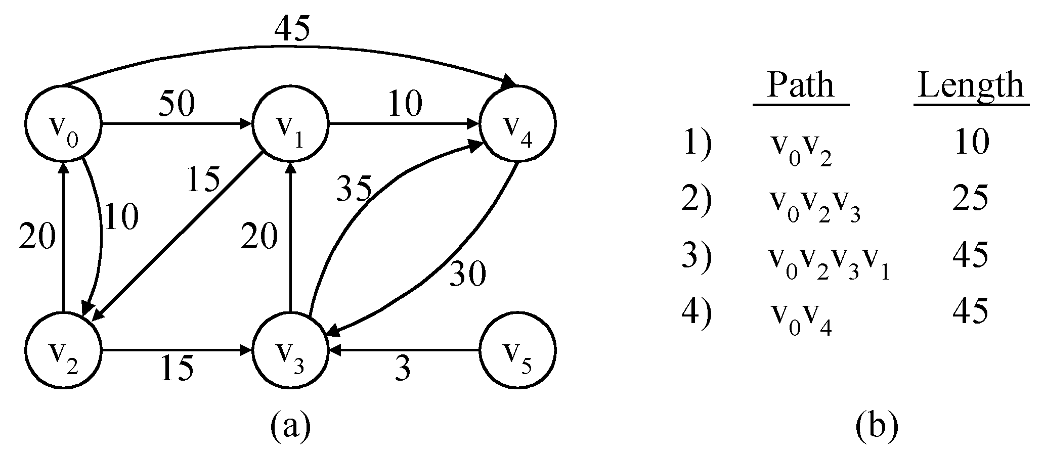
The single-source shortest path problem
shortest paths from v₀ to all destinations

Slide 63
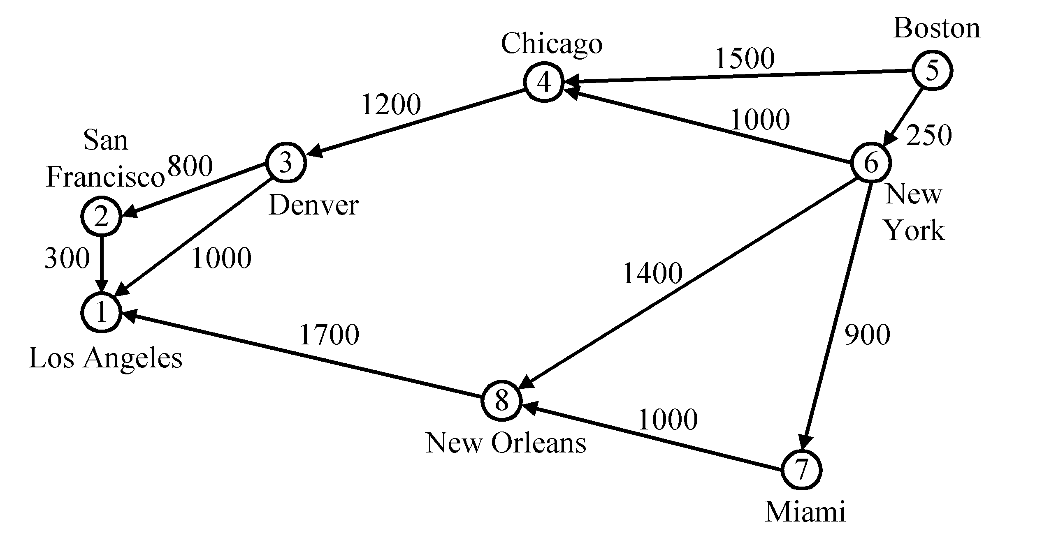
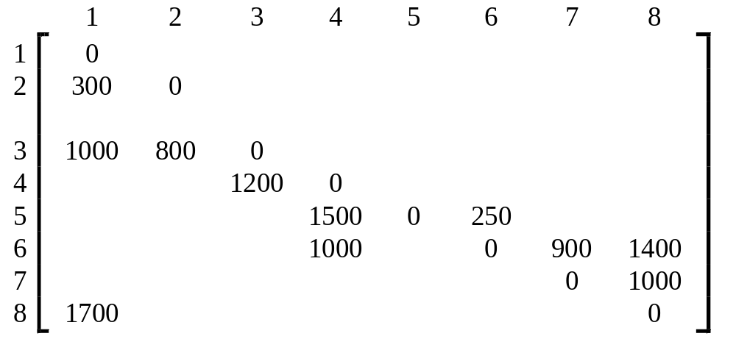
Dijkstra’s algorithm
In the cost adjacency matrix, all entries not shown are +∞.

Slide 64
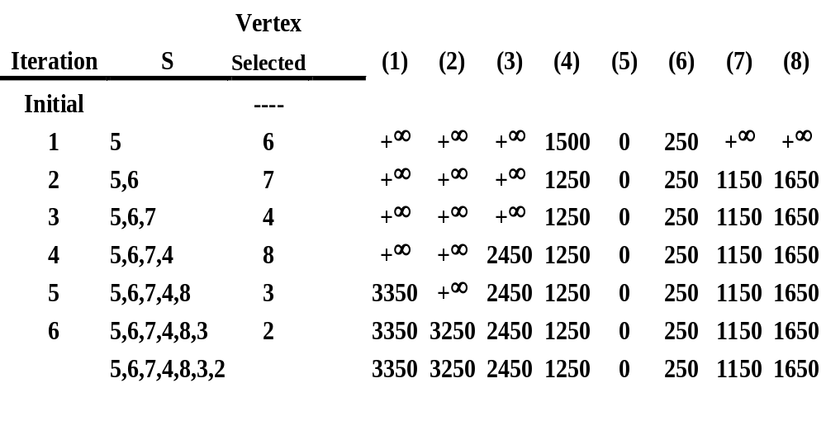
Time complexity : O(n²), n = |V|.

Slide 65
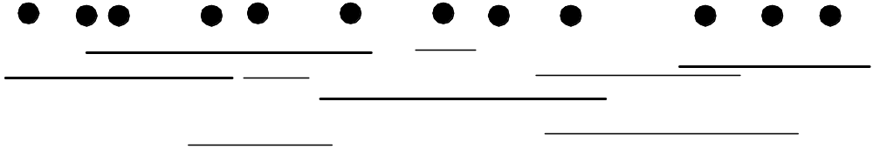
Interval Point Cover
Smallest subset of the intervals
to cover the set of points.
Greedy Alg:
Consider the leftmost uncovered point.
Of intervals that cover it,
Take the one the goes furthest to the right.

Slide 66
Interval Point Cover
Smallest subset of the intervals
to cover the set of points.
Greedy Alg:
Consider the leftmost uncovered point.
Of intervals that cover it,
Take the one the goes furthest to the right.

Slide 67
Interval Point Cover
Smallest subset of the intervals
to cover the set of points.
Greedy Alg:
Consider the leftmost uncovered point.
Of intervals that cover it,
Take the one the goes furthest to the right.

Slide 68
Interval Point Cover
Smallest subset of the intervals
to cover the set of points.
Greedy Alg:
Consider the leftmost uncovered point.
Of intervals that cover it,
Take the one the goes furthest to the right.

Slide 69
Interval Point Cover
Smallest subset of the intervals
to cover the set of points.
Greedy Alg:
Consider the leftmost uncovered point.
Done

Slide 70
Thank You!!
Q&A

